Slide 1




Effective + Ineffective
Ad Campaigns
Group 4: Julia Zlomke, Robbie Grubbs, Sharon Nwogwugwu, Zoe Meeker, Mandi Nemri

Slide 2

Non durable product - Effective
Coca-cola’s “share a coke campaign”

Slide 3
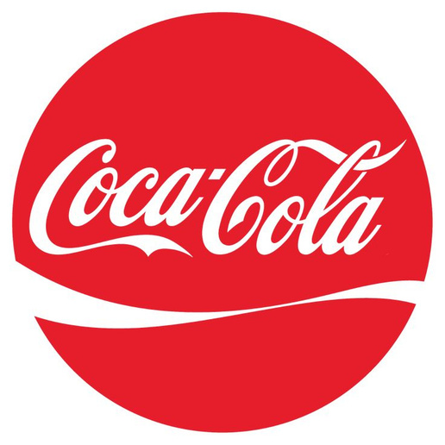


Share a Coke
Video Campaign

Slide 4


Background
Information
THE ORIGIN OF COCA‑COLA
On May 8, 1886, Dr. John Pemberton, a local pharmacist, brought his perfected syrup to Jacobs' Pharmacy in downtown Atlanta where the first glass of Coca‑Cola was poured.
It was placed on sale for five cents a glass as a soda fountain drink.
SHARE A COKE AD CAMPAIGN
This campaign was created in Sydney, Australia through a collaboration with Ogilvy marketing agency. The concept was simple: personalize Coca-Cola bottles and cans with popular names, to forge closer connections with Australian youth and spark moments of shared happiness. Coca-Cola recognized the need for a fresh approach to engaging with young consumers and its Share a Coke campaign not only renewed its image but also strategically shifted its target demographic from Baby Boomers to Millennials.
By embracing personalization and creativity, Coca-Cola successfully connected with its audience on a personal level, positioning itself as a brand aligned with the evolving tastes and preferences of the next generation while driving impressive profitability during its summer campaign in 2012 and beyond. This innovative approach resonated globally, spreading to over 70 countries and generating substantial revenue and brand exposure, cementing its status in modern marketing.

Slide 5


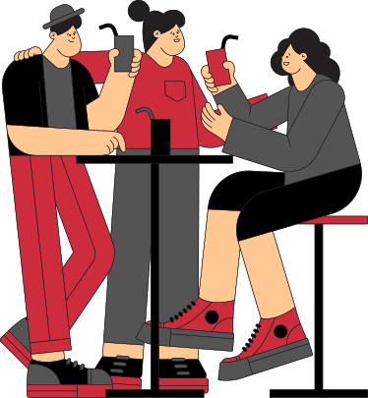
Media Strategy
DIGITAL INTEGRATION
- This helped extend the campaign’s reach and fostered user-generated content.
SOCIAL MEDIA ENGAGEMENT
- Consumers were encouraged to share photos and stories related to the campaign using the hashtag #ShareACoke.
INFLUENCER PARTNERSHIPS
- This strategy helped to amplify the reach of the campaign and create a sense of authenticity and endorsement.
INTERACTIVE DIGITAL CAMPAIGN
- A website allowed consumers to search for names, creating virtual customized Coke bottles that could be shared on social media.
Target Audience
THE PRIMARY TARGET AUDIENCE OF THIS CAMPAIGN WAS MILLENNIALS (YOUNG, 18-25-YEAR-OLD ADULTS)
THE SECONDARY TARGET AUDIENCE OF THE CAMPAIGN WAS MIDDLE-AGED PEOPLE

Slide 6


Why is it
Effective?
IT IS PERSONALIZED, SHAREABLE, AND APPEALS TO EMOTIONS.
IT SUCCESSFULLY CAPTURED THE ATTENTION OF ITS TARGET AUDIENCE.
ROUGHLY 1.25 MILLION MORE TEENS TRIED A COKE DURING THE FOLLOWING SUMMER.
SALES OF PARTICIPATING COCA-COLA PACKAGES ROSE BY A PHENOMENAL 11% IN THE US.
THE CAMPAIGN’S SUCCESS LED TO ITS EXPANSION IN OVER 80 COUNTRIES, CONTRIBUTING TO A 2% GLOBAL INCREASE IN COKE VOLUME SALES.
THE BIGGEST CONTRIBUTOR TO THE SUCCESS OF THE SHARE A COKE CAMPAIGN IS COCA-COLA'S DIVERSE MARKETING STRATEGIES AND TECHNIQUES.

Slide 7

Other
Campaign Ads
By Coca-cola
'HOLIDAYS ARE COMING' (1995)
- this ad successfully forged a connection between the brand and Christmas.
THE POLAR BOWL (2012)
- this ad focused on a group of polar bears watching the game and taking part in their own version of football. Viewers were also encouraged to visit a website where they could watch the polar bears react and interact with the game in real time.
'UPLIFTED ALEX' (2017)
- this partnership with the Fifa game helped to demonstrate the possibilities of video games as a marketing space.
‘COKE FACTORY’ (2006)
- the brand to explored its more creative side, imagining the inner workings of a vending machine after the consumer's coin is inserted.
'HISTORY OF CELEBRATION' (2010)
- combination of the World Cup track 'Wavin Flag' with footage of footballers after scoring a goal for their national team conveyed the brand's message of unity and friendship.

Slide 8

Non durable product - Ineffective
Victoria Secret’s “Perfect Body” Campaign

Slide 9

Background
Information
THE ORIGIN OF VICTORIA SECRET
Victoria’s Secret was founded in 1977 by Roy Raymond, who was an American businessman. His decision to create Victoria Secret was inspired by his uncomfortable experience at a department store to buy underwear for his wife. He then set out to create a place where men would feel very comfortable shopping for lingerie.
THE PERFECT BODY AD CAMPAIGN
Victoria Secret caused controversy when they used the words “The Perfect Body” in an ad for their Body by Victoria lingerie. Accompanied by the slogan, featured a photo with 10 models, several of which had visible ribs. The ad launched a Change.org petition which sparked a social media outrage.

Slide 10
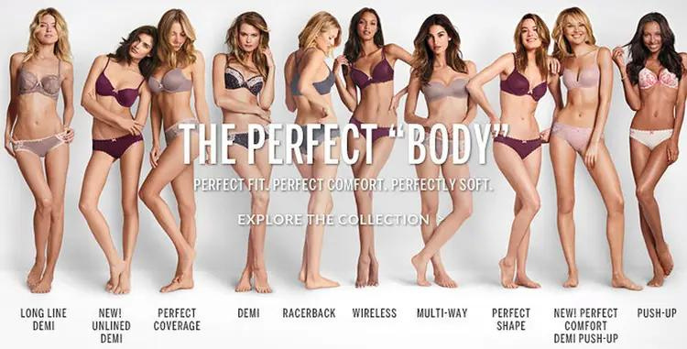
The Perfect Body
Campaign

Slide 11

Media Strategy
SOCIAL MEDIA ENGAGEMENT
The ad was supposed to be inspiring for women, however it did not turn out that way
PUBLIC RELATIONS
Their goal was to partner with the outside media but when the ad did not go as plan media outlets declined
INTERACTIVE DIGITAL CAMPAIGN
Their website would be the landing page for the Perfect Body campaign which would drive buyers to the campaign.
Target Audience
THE PRIMARY TARGET AUDIENCE OF THIS CAMPAIGN WAS WOMEN OF ALL SIZES
THE SECONDARY TARGET AUDIENCE OF THE CAMPAIGN WAS YOUNG-ADULT WOMEN

Slide 12

Why is it
Ineffective?
THE CAMPAIGN LACKED DIVERSITY IN SIZING OF WOMEN
THE MESSAGE WAS INSENSITIVE AND RUBBED PEOPLE THE WRONG WAY
THE TIMING OF THE AD CAME AT A BAD TIME AS DIVERSITY & INCLUSION WERE HUGE IN THE FASHION INDUSTRY
THEY RECIEVED A LOT OF CRITICISM BECAUSE EVERYONE WAS OFFENDED, RIGHTFULLY SO
THEY HAD A MISSED OPPORTUNITY TO ENCOURAGE WOMEN EMPOWERMENT
THE CAMPAIGN WAS CRITICIZED FOR LACKING AUTHENTICITY. BUYERS WANT BRANDS AND COMPANIES TO BE VERY AUTHENTIC

Slide 13
Other
Campaign Ads
By Victoria Secret
VICTORIA SECRET FASHION SHOW
The annual Victoria Secret Fashion show is always a hit for the brand
BODY BY VICTORIA
This campaign emphasized comfort fit, and everyday wearability items
ANGELS CAMPAIGN
This campaign showcases the Victoria Secret Angels have always been a fan favorite
BODY BY VICTORIA FRAGRANCE CAMPAIGN
Victoria Secret successfully marketed their fragrance line that blew off shelves
HOLIDAY CAMPAIGN
Victoria Secret holiday campaign has always been a good one, and one that buyers wait for all year long

Slide 14





Durable product - Effective
‘s “Do What You Can’t”

Slide 15
#DoWhatYouCan’t
Notes:
https://campaignsoftheworld.com/tv/samsung-do-what-you-cant-2019/
#DoWhatYouCant
film of confronting then overcoming limits

Slide 16

Background
Information
Samsung
Founded March 1st, 1938 in Taegu, South Korea by Lee Byung-Chull as a grocery trading store that traded and exported noodles and other goods to China
The largest South Korean Chaebol (a large family-owned business conglomerate) with multiple affiliated brands under the Samsung brand
#DoWhatYouCant
One of the world’s largest producers of electronic devices
First ad (‘The Ostrich’ s8 ad) developed by Leo Burnett Advertising Agency as Samsung’s first commercial dedicated to the Latin American region
Part of the ‘Do What You Can’t’ global campaign, directed by Tal Zagreba
Concept originated with Samsung’s 2016 Olympic campaign ‘The chant’ to extend the message into an overarching brand philosophy
Notes:
http://www.mandmglobal.com/samsung-develops-first-latam-ad-campaign-in-global-do-what-you-cant-push/

Slide 17




Why is it
Effective?
POSITIVE CAMPAIGN ABOUT BEING DIFFERENT, DEFYING LIMITATIONS, AND OVERCOMING BARRIERS
THE CAMPAIGN APPEALS TO THE EMOTIONS NOT JUST INFORMATION
THE PHILOSOPHY APPEALS TO THE YOUNGER GENERATION BECAUSE IT WORKS TO INSPIRE
HELPED PIVOT THE BRAND FROM JUST A “TECH BRAND” TO STRIVING TO BE A ‘BELOVED ICONIC BRAND’
Notes:
https://vincenzolandino.medium.com/good-brand-philosophy-samsungs-do-what-you-can-t-campaign-c80ed7710188
https://www.campaignlive.co.uk/article/samsung-underscores-dowhatyoucant-brand-strategy-new-global-ad-s8-galaxy/1429949

Slide 18
#DoWhatYouCan’t
Continued
and more...

Slide 19

Durable product - Ineffective
Microsoft's "Bing It On"

Slide 20

Background
Information
THE ORIGIN OF MICROSOFT
Founded by Bill Gates and Paul Allen on April 4, 1975
Bing was Launched in 2009
“A more visually appealing and user-friendly search engine compared to predecessors”
THE “BING IT ON” CAMPAIGN
Launched in 2012 as a Blind comparison test between Bing and Google search results.
Encouraged users to use both search engines and choose which search results they preferred, not knowing which they were using.
Failed to significantly dent Google's dominance in the search engine market.

Slide 21
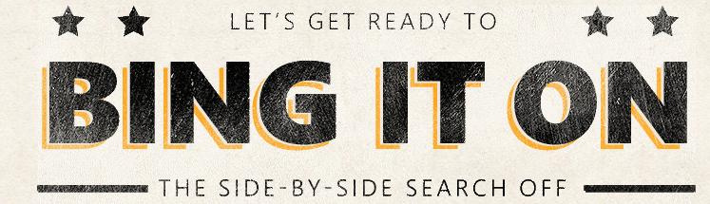
Bing it On
Campaign

Slide 22


Media Strategy
BLIND COMPARISON TEST
Used a “Pepsi Challenge” inspired campaign by encouraging users to conduct anonymous searches on Bing or Google and decide which was better.
ONLINE & OFFLINE ADVERTISING
Used many channels, including social media, email, display ads, television, and print to reach a broad audience and maximize the campaign’s visibility.
INTERACTIVE WEBSITE
Used an interactive website as a central hub for the challenge itself, user testimonials, and resources.
PUBLIC RELATIONS
Used public relations strategies to generate buzz and credibility, including doing media outreach to journalists and bloggers like TechCrunch, CNN Business, and ClickThrough.
Target Audience
THE PRIMARY TARGET AUDIENCE OF THIS CAMPAIGN WAS GENERAL INTERNET USERS.
Bing it on
THE SECONDARY TARGET AUDIENCE OF THE CAMPAIGN WAS TECH-SAVVY INTERNET USERS.

Slide 23
Why was it
Ineffective?
Search Quality Perception: Many users still perceived Google as providing more accurate search results, so it was difficult to convince users to switch to Bing after one challenge.
Brand Loyalty: Google already established a strong brand presence and loyalty in the search engine market. Google users were not as willing to switch from Bing even with proof they preferred Bing more.
Market Share: While Bing reached an all time high in market share of 18.2%, Google was still a market share leader with 67.3% by the end of 2013.
Advertising Impact: While the "Bing it On" campaign attracted some attention, it didn't have as lasting of an impact. The campaign ran from about a few months to a year, and any market share it gained went away fairly quickly.

Slide 24

Service - Effective
Air BnB: “We Accept”

Slide 25
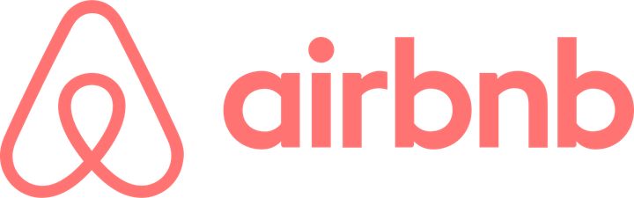
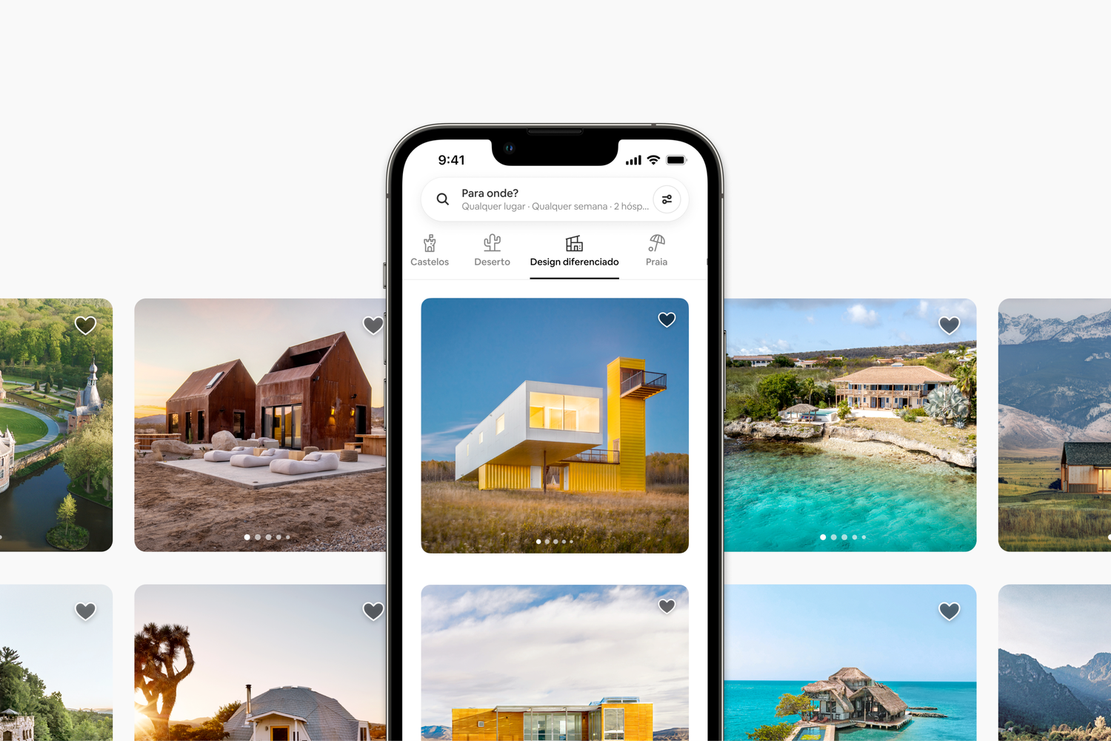
Background
Information
Online marketplace for vacation rentals
Users can host their home/apartment for rent
Founded 2008 in San Francisco, CA

Slide 26


Slide 27

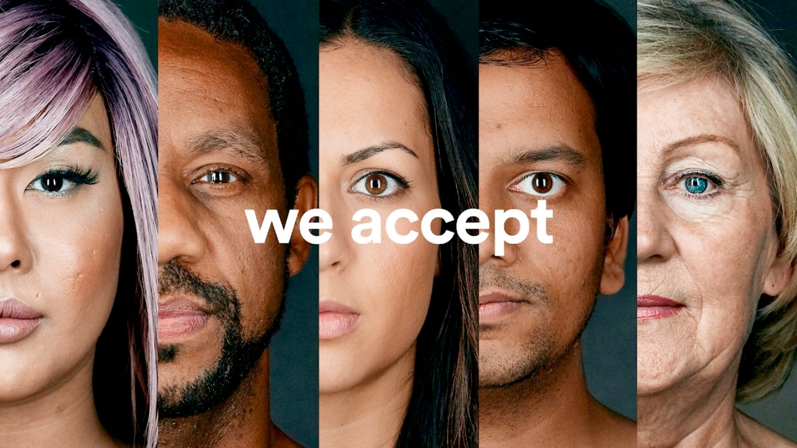

“We Accept”
Response to travel ban & discrimination
2017 Super Bowl #weaccept
$4 million donation to the International Rescue Committee
Notes:
This campaign was a response to the 2016 travel bans to muslim majority countries as well as ongoing discrimination in the housing and hotel industry
It launched during the 2017 superbowl with the hashtag we accept
the campaign didn't end there. Airbnb donated $4 million to the international rescue committee to provide housing relief to thousands
https://medium.com/@l.gamble/breaking-down-airbnbs-weaccept-campaign-f4f46f6c640f

Slide 28
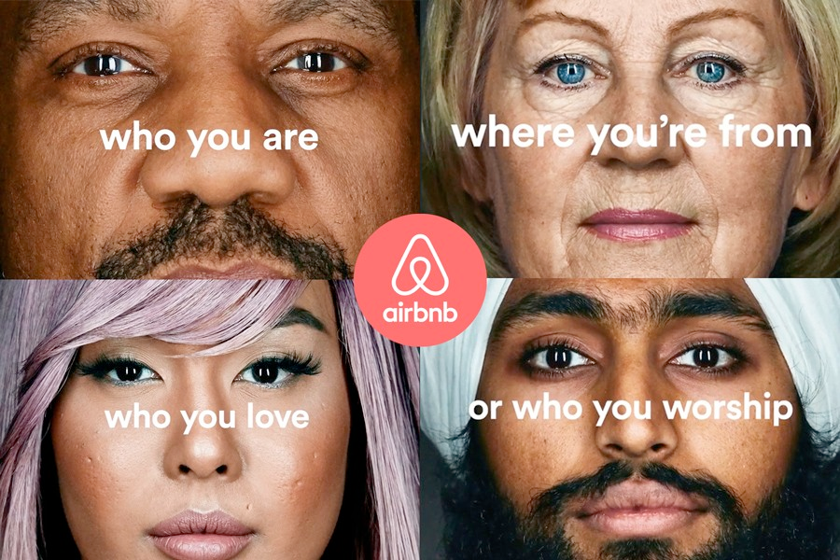
Why was it
Effective?
85% positive response
2018 Shorty Social Good Awards
Instagram & Facebook presence
Multi-platform campaign
Hashtag campaign (#weaccept)
#1 Hashtag during 2017 SuperBowl
Notes:
This campaign received 85% positive responses from the public
They received multiple honors at the 2018 Shorty social good awards, which recognises marketing campaigns. They recieved awards in the following categories:
They were the most searched hashtag during the superbowl when the ad aired
In addition to all these awards, we believe this campaign was effective because message aligned well with their service and mission to provide housing accommodations
https://shortyawards.com/2nd-socialgood/weaccept

Slide 29

Service - Ineffective
Wells Fargo: “Re-Established”

Slide 30
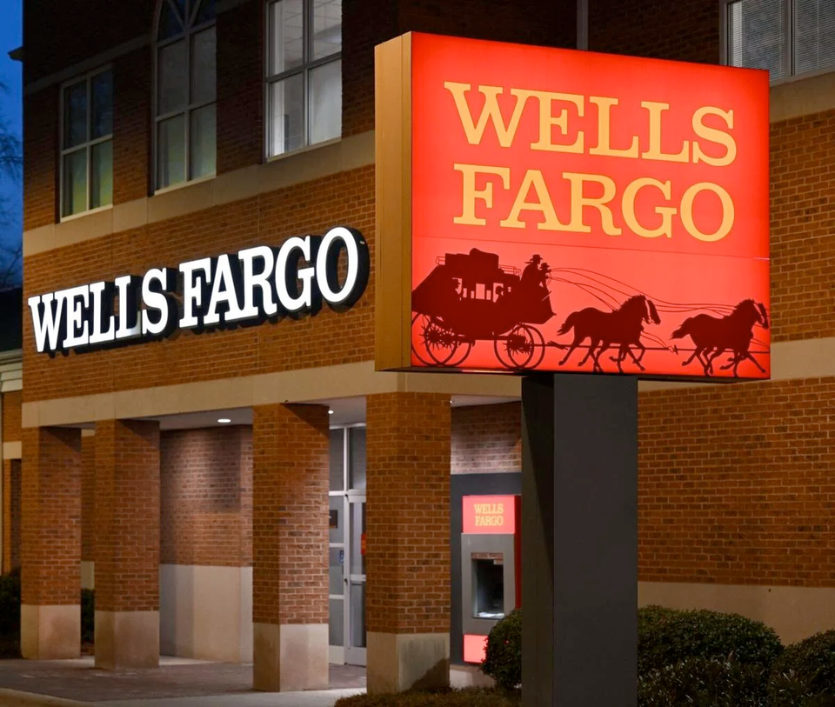
Background
Information
Multinational financial services company
Bank accounts, loans, mortgages, etc.
Founded 1852 in New York, NY

Slide 31


Slide 32
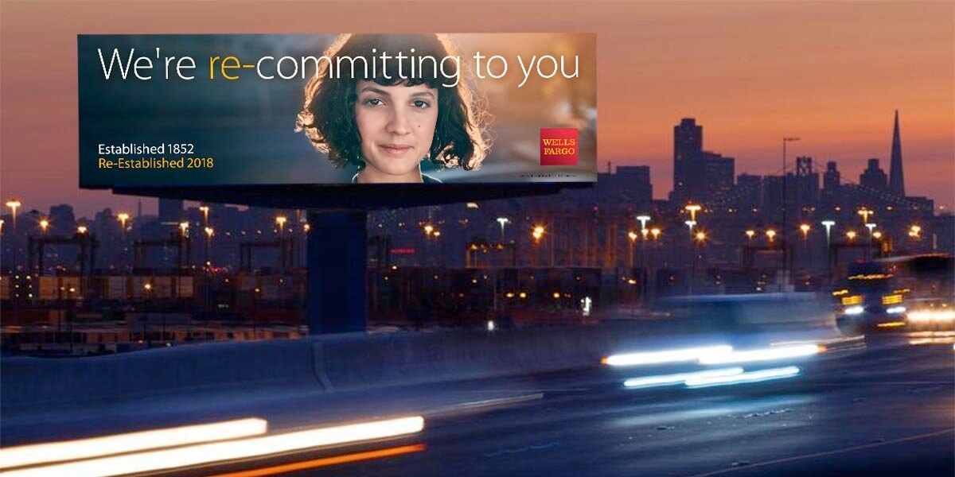
“Re-Established”
2018 Brand campaign aimed to re-establish trust with stakeholders
Response to fake accounts scandal
Campaign ran on all platforms (TV, Print, Social media)
Notes:
this campaign aimed to re establish trust with stakeholders after the fake accounts scandal where millions of fake accounts were opened in customers names without their consent, such as credit cards to increase sales data
the campaign was widespread and ran on all platforms including tv, print, social media, and more
https://www.latimes.com/business/la-fi-wells-fargo-ad-campaign-20180509-story.html

Slide 33
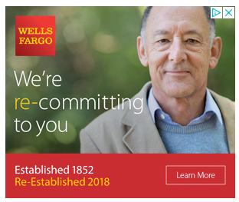
Why was it
Inffective?
“I was looking for someone from Wells Fargo, like a human being, to say, ‘We accept responsibility, this is our plan, I personally own this plan and I’m going to hold myself responsible,’ ”
-Deb Gabor, CEO of Sol Marketing
Notes:
Quote from deb gabor
overall the campaign came across as inauthentic, and they did not adequately follow through with customers through their actions
https://www.latimes.com/business/la-fi-wells-fargo-ad-campaign-20180509-story.html

Slide 34
Thank you
Questions?

